Slide 1
Practicing Innovation
Alpha Chi Rho

Slide 2
Innovation #1
Excuse Form for Events

Slide 3

The Problem
In the past, we have had a much lower participation and accountability for who in the Brotherhood was excused from attending events or Brotherhood responsibilities such as our Chapter meetings
Our old way of sending excuses was simply sending an email 24 hours in advance and this would clutter the email of the Secretary, thus taking much longer to compile who was excused or not

Slide 4
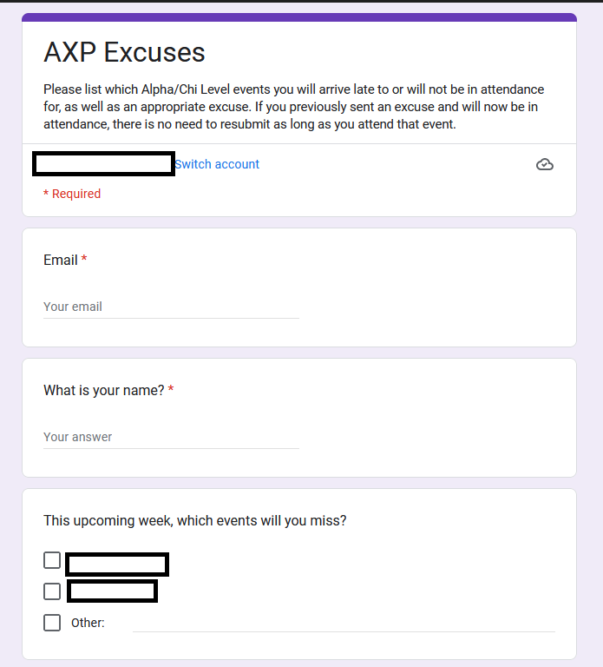
The Solution
To mitigate this, we have created a new Google Form solely for excuses.
It is linked in every email for our events in order to hold Brothers better accountable for making sure they send in their excuses in a timely and organized manner

Slide 5
Outcome
With this response form being used since the end of the last academic year, we have seen much higher recorded participation at both Brotherhood responsibilities as well as been able to better track those who are able to come to external events that Alpha Chi Rho hosts.
It has also streamlined the work for our Secretary to check who will arrive late to meetings or will not be able to make it with a given 24 hours notice via the Google Form

Slide 6
Innovation #2
Towel Roller Assignments

Slide 7
The Problem
Within our bathrooms, we have 3 towel rollers instead of using paper towels or rags to dry our hands with.
Not many people knew how to properly wash and dry these towels except for the assistants to the facilities manager, whom were not available most of the time.
Therefore, the towels were not being cleaned and replaced in a timely manner.

Slide 8
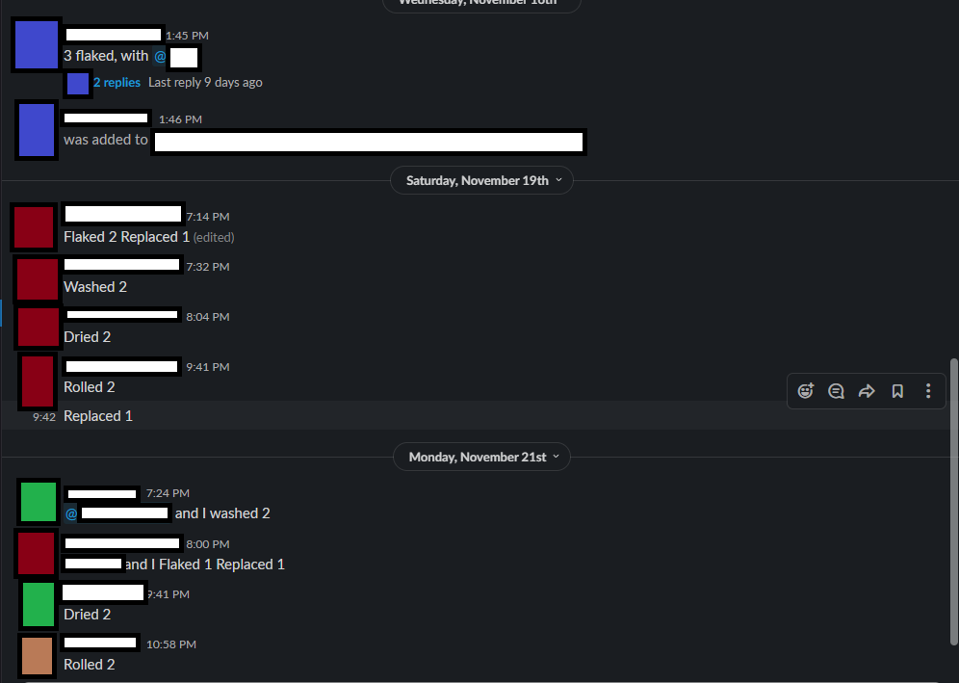
The Solution
Each week now, 2 sets of a group of 3 Brothers are assigned responsibility for going through the process of cleaning the towels.
One Brother in the group already knows how to do them, so they are responsible for teaching the other two, so they can then teach others in the future.
All documentation to say that the towels are going through each step of the cleaning process is recorded in a Slack Channel that the House Manager routinely checks.

Slide 9
Outcome
As a result of this new system, we have not recently had the issue of not having a towel to dry our hands in the bathrooms of our main house as there are always a new supply of cleaned towels.

Slide 10

Thank you!

